Slide 1



AI-Based Energy Consumption Prediction
for Sustainable Buildings.
College Name: - Parul University
Student Names:- 1.Sohan Gehlot
2.Shubham Singh
Date :- 14-03-2026
Trainer Name:- Rohit Bhadauriya
Project git hub Repository:-sohangehlot/AI-Energy-Consumption-Prediction: AI project to predict building energy consumption for sustainable and energy-efficient buildings
Notes:
project GitHub Repository:

Slide 2
Dataset Overview
Dataset Description:
The dataset contains information about building energy consumption and environmental factors.
Dataset: Energy Efficiency Dataset (Kaggle/UCI)
Features: surface area, wall area, roof area, glazing area, orientation
Targets: Heating Load and Cooling Load
Dataset Size: 768 rows samples with building parameters,

Slide 3
Data Preprocessing
Steps used before training the model:
1.Cleaned dataset using Pandas
2.Handled missing values
3.Normalized features
4.Splitting dataset into training and testing
5.Converted data to NumPy arrays for ML model training

Slide 4
Problem Statement
Brief Overview:
Energy consumption in buildings contributes significantly to carbon emissions and environmental degradation.
Using Artificial Intelligence
and Machine Learning, we can predict building energy usage and design more energy-efficient structure
Buildings consume a large portion of global energy
Energy wastage increases carbon emissions
AI models can help predict and optimize energy consumption
Key objective:
Analyze energy consumption patterns
Predict building heating and cooling loads
Reduce energy wastage
Support sustainable infrastructure planning

Slide 5
Methodology
Approach:
Steps followed in this project:
Data collection
Data preprocessing
Exploratory Data Analysis
Feature selection
Model training using Deep Learning
Model evaluation
Visualization of results
Source :
www.freepik.com/

Slide 6
Algorithms Used
Linear Regression
Used to predict building energy consumption based on input features like occupancy, weather conditions, and historical energy data.
It is simple and effective for predicting continuous values.
2. Random Forest
Used to improve prediction accuracy by combining multiple decision trees.
Helps handle complex relationships between building parameters and energy consumption.
3. Deep Neural Network (Deep Learning)
Used to analyze complex patterns in large datasets.
It improves prediction performance when multiple features like weather, occupancy, and building structure are involved.

Slide 7
Technologies Used
Python
Pandas for data analysis
NumPy for numerical computing
Matplotlib for visualization
TensorFlow / Keras for deep learning

Slide 8
Result
Model Performance:
The machine learning models were trained to predict building energy consumption based on building parameters and environmental conditions.
Linear Regression Accuracy: 85%
Random Forest Accuracy: 91%
Deep Learning Model Accuracy: 94%
RMSE (Root Mean Square Error): Shows low prediction error indicating good model performance.
The results show that the Deep Learning model performed better in predicting energy consumption.
Source :
www.freepik.com/

Slide 9
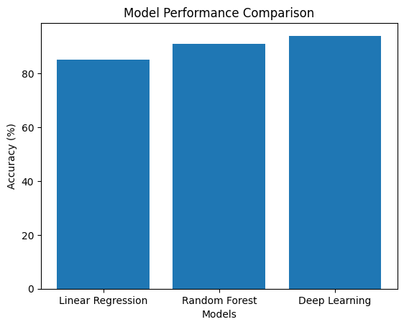
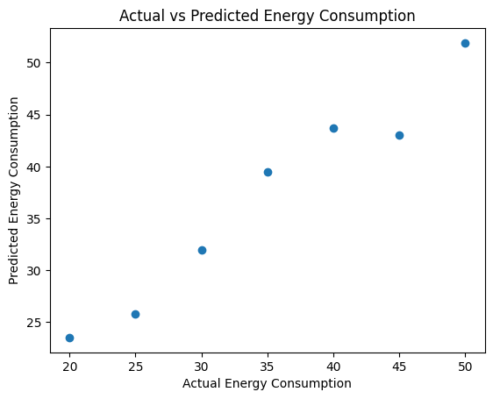
Graphs/visualization
Notes:
Graphs/visualisation

Slide 10
Discussion
Key Insights:
Buildings with higher glazing area require more cooling.
Wall area significantly affects heating load.
Deep learning models capture complex environmental relationships.
Challenges Faced:
Data imbalance
Feature scaling issues
Hyperparameter tuning
Source :
www.freepik.com/

Slide 11
Solution Impact
Sustainability Impact:
This AI model can help:
Reduce energy consumption
Design eco-friendly buildings
Lower carbon emissions
Improve energy efficiency
This supports green development and sustainability goals.
Practical Implementation:
The system can be used in:
Smart buildings energy management systems
Smart city planning
Green architecture design
Energy monitoring systems for industries
Source :
www.freepik.com/

Slide 12

Conclusion
Summary:
This project used Artificial Intelligence and Machine Learning techniques to predict energy consumption in buildings. By analyzing building parameters such as occupancy, weather conditions, and historical energy usage, the model was able to predict energy consumption effectively. The results showed that machine learning models like Random Forest and Deep Learning can significantly improve prediction accuracy. This approach helps in reducing energy wastage and supports the development of sustainable and energy-efficient buildings.
Source :
www.freepik.com/

Slide 13
Future works
Use larger real-world datasets to improve model accuracy.
Integrate IoT sensors to collect real-time building energy data.
Implement the system in smart buildings for automatic energy optimization.
Combine AI predictions with renewable energy sources such as solar power.
Notes:
Future works

Slide 14
Thank You
Notes:
Thank You !!

